Slide 1
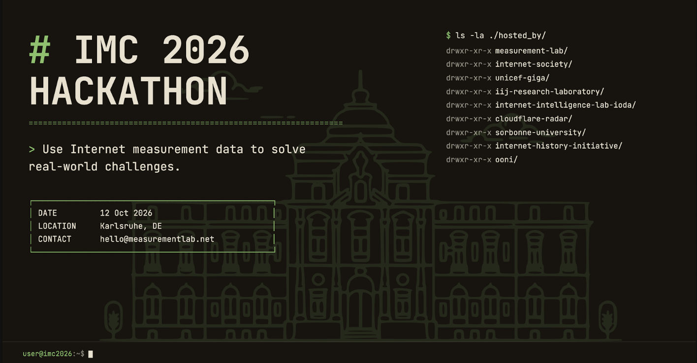

Slide 2
Schedule
09:00-09:30 Sign in and coffee
09:30-10:30 Introduction to datasets
10:30-11:00 Team formation
11:00-12:00 Working Time
12:00-13:00 Lunch
13:00-14:45 Working Time
14:45-15:00 Break
15:00-16:00 Working Time
16:00-17:00 Share outs

Slide 3
Introductions
Measurement Lab - Pavlos Sermpezis
Internet Society - Amreesh Phokeer
UNICEF Giga - Shilpa Arora & Vipul Bhavsar
IIJ Research Laboratory - Romain Fontugne
Internet Intelligence Lab; IODA - Zachary Bischof
Cloudflare Radar - Lai Yi Ohlsen
Internet History Initiative - Jim Cowie
OONI - Arturo Filastò (online)

Slide 4
Links
GitHub https://github.com/m-lab/open-measurement-hackathon/
Discord https://discord.gg/Mx5jkvE4R
Policies for ACM activities and events
  Reporting Unacceptable Behavior
  Policy Against Harassment

Slide 5


Slide 6
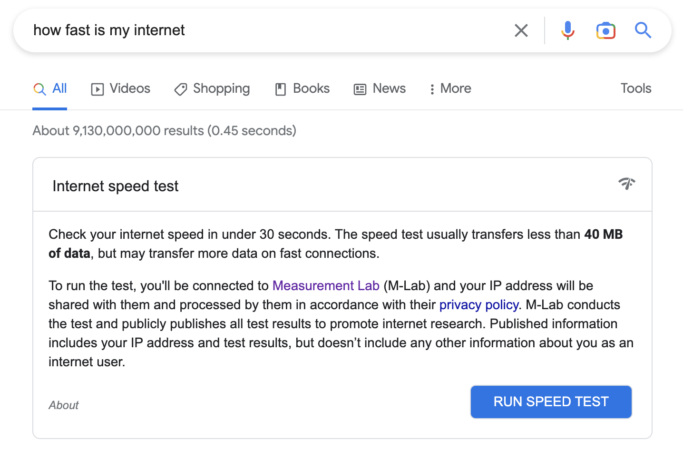
M-Lab

Slide 7
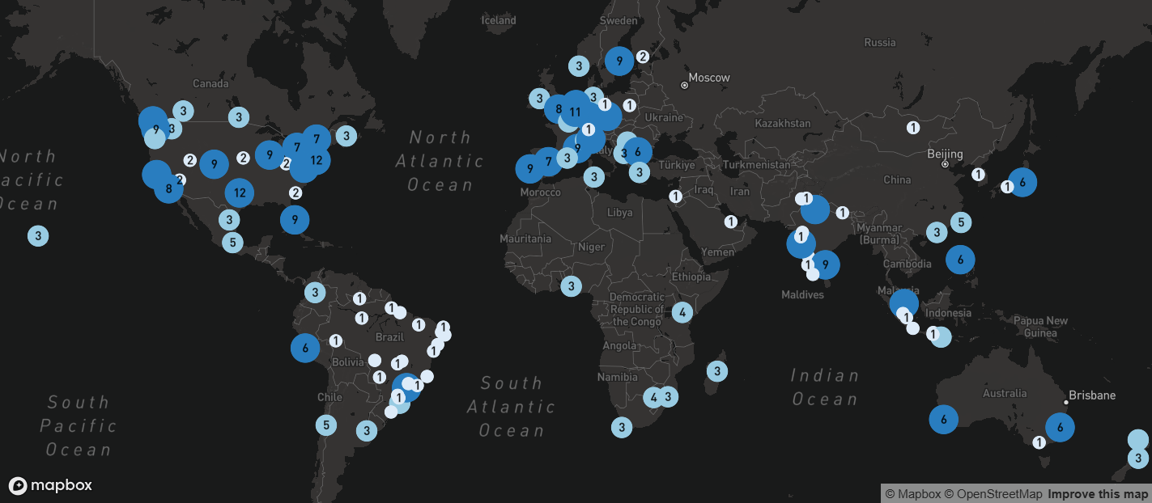
M-Lab’s platform
400+ servers globally
  https://www.measurementlab.net/status/
40+ countries / 100+ metros,
50+ transit providers

Slide 8
M-Lab measurements
M-Lab measurement services
  Network Diagnostic Tool, aka. NDT, aka “speed test”
  Other: Wehe, Reverse traceroute, Neubot/DASH
Sidecar Services
  Traceroute (from M-Lab server back to the client/user)
  PCAP collects packet headers for all incoming TCP flows
  TCP Info collects statistics for every open TCP socket

Slide 9
Network Diagnostics Tool (NDT)
NDT is our most frequently run test
  NDT measures the single-stream performance of bulk-transport capacity, more commonly referred to as a “speed test”
6+ billion tests total
4+ million tests per day, on average
> 8 PiB of data total
  Increase rate > 1 PiB since last year

Slide 10
Accessing M-Lab Data
To access M-Lab’s public data, you need to sign up for the discuss@ list
  https://groups.google.com/a/measurementlab.net/g/discuss?pli=1
Then you can access the data through BigQuery
  Tutorial: https://www.measurementlab.net/data/docs/bq/quickstart/
  BigQuery: https://console.cloud.google.com/bigquery?project=measurement-lab
  Schema (for ndt7 dataset): https://www.measurementlab.net/tests/ndt/ndt7/
    find details for other datasets https://www.measurementlab.net/data/
Tools & Languages/Frameworks
  BigQuery - SQL
  CoLab - Python, Pandas (e.g., see IMC 2023 examples & Optima shutdown example)

Slide 11
Introducing two new datasets
Monthly stats
  Distribution (percentiles) of Download & Upload throughput, latency, packet loss rate
  … per country, state, region, metro
  … per ASN
  … per month
HERMES
  Performance & congestion detection per {ASN, metro}
  Annotated traceroutes (geo, ASN, IXP, distance, etc. per hop) per NDT measurement

Slide 12
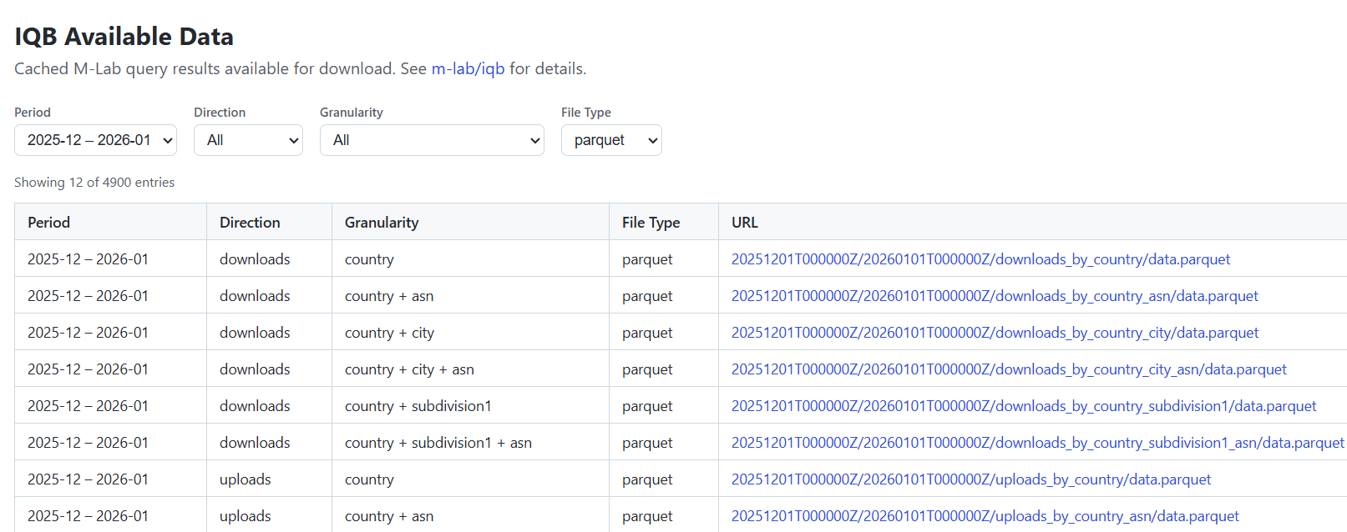
Monthly stats dataset
Data portal: https://www.measurementlab.net/data/stats/
Example notebooks: https://github.com/m-lab/mlab-notebooks/tree/main/monthlystats

Slide 13
HERMES dataset
HERMES documentation https://www.measurementlab.net/tests/hermes/
(see also links in there)
Traceroute Enrichment (part of HERMES pipeline) https://www.measurementlab.net/tests/hermes/methodology/path-enrichment/

Slide 14
M-Lab’s project ideas
Dashboard & Insights (using M-Lab’s monthly stats dataset)
Integrate M-Lab’s monthly stats dataset to Internet Yellow Pages
M-Lab’s annotated traceroutes dataset
“CensorScope”: Dashboards for Internet shutdown and throttling detection
Extending the Internet Quality Barometer (IQB) library with more datasets
“TCP Showdown”: Comparing MSAK and NDT Measurements

Slide 15


Slide 16


Slide 17


Slide 18
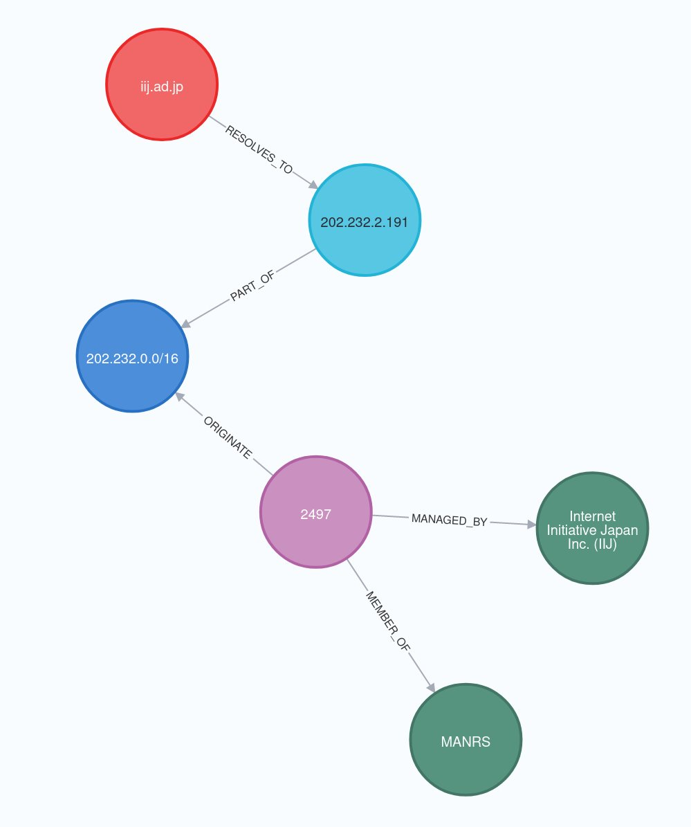
Internet Yellow Pages
Knowledge graph for Internet:​
80+ datasets (PeeringDB, CAIDA, RIPE, APNIC, Cloudflare, OONI, BGPKit, BGP.Tools, IHR, …)​
Available online at:​
https://iyp.iijlab.net
Or download snapshots at: https://ihr-archive.iijlab.net

Slide 19
IYP: Benefits
Great for sneak peek in numerous datasets
Cut time to insights
Also good for extracting/filtering a dataset
List of available datasets:
https://github.com/InternetHealthReport/internet-yellow-pages/blob/main/documentation/data-sources.md

Slide 20
Steep learning curve
Take a look at Cypher examples:
IYP Tutorial: https://tutorial.iyp.ihr.live/
  Especially the part on how to query from your code
IYP Gallery: https://github.com/InternetHealthReport/internet-yellow-pages/blob/main/documentation/gallery.md
IYP Notebooks: https://github.com/InternetHealthReport/iyp-notebooks
IYP MCP server: https://mcp.iyp.ihr.live/mcp
Ask me for help!

Slide 21
Project Ideas
[IIJ - Project 1] Ukraine IPv4 prefixes exodus
[IIJ - Project 2] Starlink entering transit market
[IIJ - Project 3] China rolls out ROA
[IIJ - Project 4] Reproducing an IMC paper with IYP
[IIJ - Project 5] Augmenting your favorite dataset by integrating it to IYP

Slide 22



Slide 23


Slide 24
Cloudflare Radar
Cloudflare Radar is a hub that showcases global Internet traffic, attack, and technology trends and insights. Cloudflare Radar is powered by data from Cloudflare's global network, as well as aggregated and anonymized data from Cloudflare's 1.1.1.1 public DNS Resolver.
In some cases Cloudflare Radar uses data from PeeringDB (interconnection meta-information) and APNIC (visible ASNs customer population measurements).
With Radar, you can access trends and insights, like the adoption of new technologies, browsers or operating systems. Radar also keeps up to date with relevant events around the world to provide information on Internet activity patterns.
https://radar.cloudflare.com/ is built on top of the Radar API (specification, documentation).

Slide 25
speed.cloudflare.com
Cloudflare provides a speed test at speed.cloudflare.com, which is powered by an open Javascript library. It receives about ~200k tests per day, on average.
You can view the results of these tests in aggregate through Radar on the Internet Quality page.
The raw results are available through the Radar API and M-Lab’s Public Dataset in BigQuery.
More info about how Cloudflare’s speed test works: [blog post]

Slide 26
Radar Data Explorer
The Radar Data Explorer (https://radar.cloudflare.com/explorer) is a web-based interface designed to simplify the process of building, and viewing the results of, more complex API queries.
It also provides example API calls and responses for the queries built using the interface.
More information is available at https://blog.cloudflare.com/radar-data-explorer-ai-assistant/#building-a-query-directly
A free Cloudflare account is required to generate an API token that is needed to make API queries. If you do not currently have a Cloudflare account, or have not yet generated the necessary token, please follow these steps…

Slide 27
Creating a Cloudflare account
Go to https://dash.cloudflare.com/sign-up
If you want to login with your Google/Apple/Github account, click the appropriate link.
Otherwise, enter your email address and a password in the appropriate fields, check the box to verify that you are a human, and click “Sign up”.
Click the link in the “[Action required] Verify your email address” email sent to the address associated with the account.

Slide 28
Creating an API token
Login to the Cloudflare dash at https://dash.cloudflare.com/login
Click the profile icon in the upper right corner, and click “Profile” in the drop-down menu.
On the Profile page, click “API Tokens” from the left-side navigation bar.
Click the “Create Token” button in the “API Tokens” card on the “User API Tokens” page.
Click the “Use template” button next to “Read Cloudflare Radar data”
Under “Account Resources”, choose the account associated with your login from the drop-down menu.
Click the “Continue to summary” button at the bottom of the page.
Click “Create Token” on the next page
If token creation was successful, it will be displayed in a text box. Copy it to a password manager or other secure location, as it will not be shown again. You can confirm that the token is valid and active by executing the curl command shown on the page.

Slide 29
Possible Project
[Cloudflare Radar - Project 1] Aggregate and visualize metrics across platforms
Radar provides a number of metrics that can help assess the occurrence and impact of a potential Internet disruption. (These include traffic metrics for HTTP requests, Netflows, and DNS; TCP resets & timeouts; bandwidth & latency; and announced IP address space.) However, these are largely all from a single platform. In order to corroborate observed disruptions, it would be helpful to have an aggregated view that includes metrics from other platforms.

Slide 30
Internet History Initiative
https://internethistoryinitiative.org/

Slide 31


Slide 32
The Open Observatory of Network Interference Foundation (OONI) is an NGO that develops open source software and open data to empower decentralized efforts in documenting internet censorship around the world

Slide 33
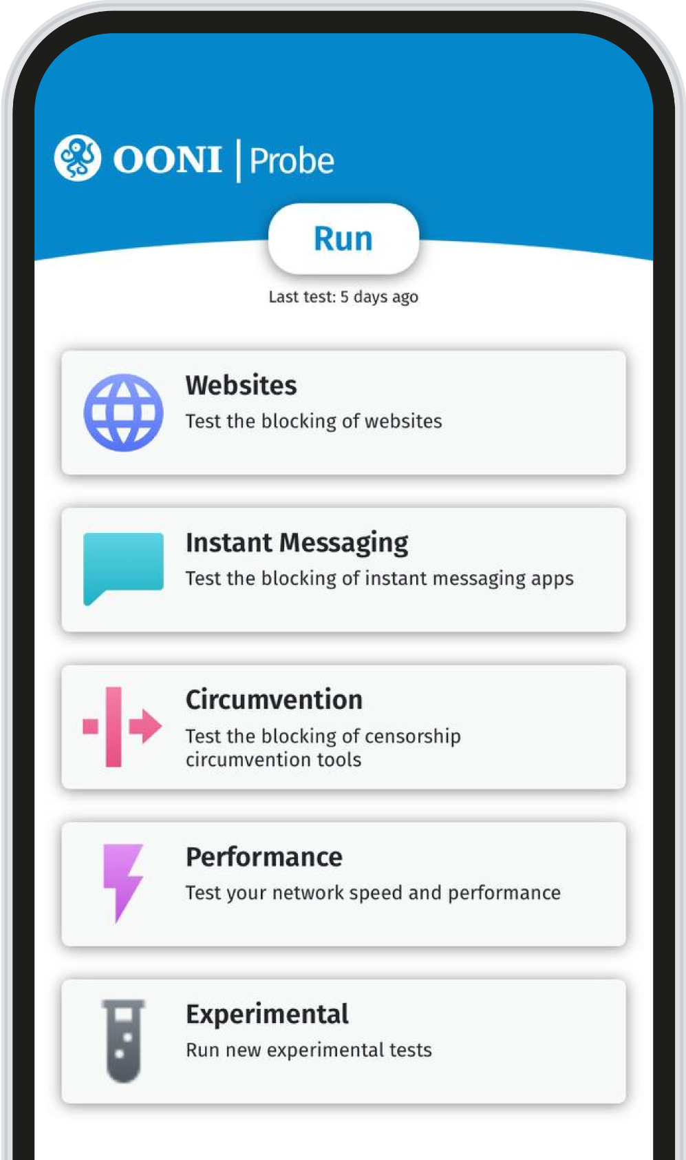
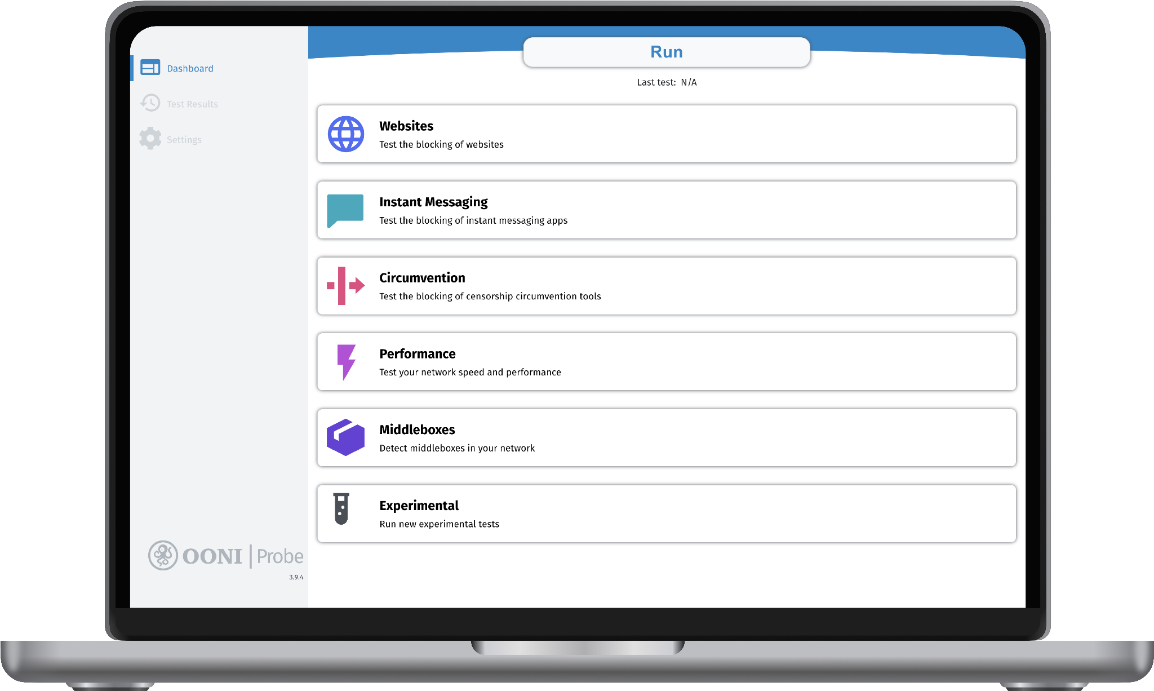

Hundreds of thousands of people all over the world have installed OONI Probe on their mobile phone or computer to collect evidence of internet censorship in their country.
All our software is developed in the open and released as free software: https://github.com/ooni/
Open Source Software

Slide 34


OONI Explorer is the world's largest open data repository on internet censorship worldwide.
From 2012 to 2024 we have collected and published 2 Billion network measurements from 241 countries and territories covering 27 thousand networks.
Open Data

Slide 35
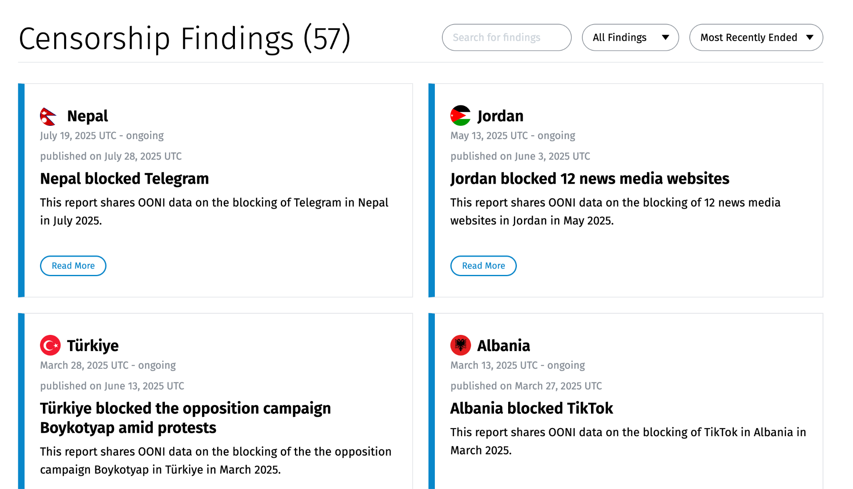
OONI Explorer Findings

Slide 36

OONI Data
OONI data can be accessed through the public OONI Explorer web interface. OONI Explorer has a component called the Measurement Aggregation Toolkit (MAT), which can be used to produce plots of measurements over time. OONI Explorer is backed by OONI API, links for the relevant API endpoints used to produce the charts can be found by clicking on the JSON Data or CSV Data on the MAT pages.

Slide 37
Data Access for IMC Hackathon
For the IMC hackathon we are also offering direct access to the underlying clickhouse database, the schema of which is available in the relevant documentation page: https://docs.ooni.org/data/oonidata-analysis-db/.
In order to query the clickhouse database you may use the following credentials to access the OONI jupyter notebook server:
URL: https://notebook.ooni.org/
user: imc2026
password: aGoodUserIsAGentleUser
Please note that this is a shared instance, so please try to limit resource usage as much as possible. If you need to run particularly memory or CPU heavy computation it’s recommended you export a dump of the data and run these computations on your own machine.
Make a copy of the notebook DUPLICATEME.ipynb and work on that for your project.

Slide 38
OONI Project Ideas
OONI as an outage signal: submission lag, volume, and cross-validation with IODA
Analyze and visualize internet censorship data
Improve OONI’s automatic censorship detection system
TLS certificate divergence explorer
Who gets blocked? Mapping OONI's blocked targets onto IYP

